Slide 1

Data Engineering Assignment
Sentiment Analysis for
Domino Pizza
Presented by:
Sit Yie Sian
Leong Sheng Mou
Tan Jacqueline
Loke Tze Min

Slide 2

Introduction
01

Slide 3

Short Introduction of
Domino Pizza
Founded in Malaysia in 1997
High-quality ingredient and servicing assurance
Over 240 locations across the country
One of the leading pizza delivery chains

Slide 4
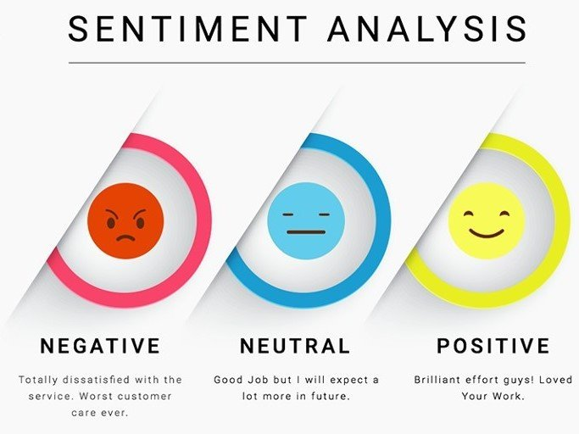
About the project:
To analyze the reviews of Domino Pizza with sentiment analysis
To observed overall sentiment are fall into which category

Slide 5
Dataset Understanding
Columns | Explanations
commentID | The ID of each comment
commentURL | The URL of each comment
commenterID | The commenter ID which also know as profile ID
commenterName | The name of the commenter shown in Facebook
commenterText | The comment posted on the Domino official page.

Slide 6
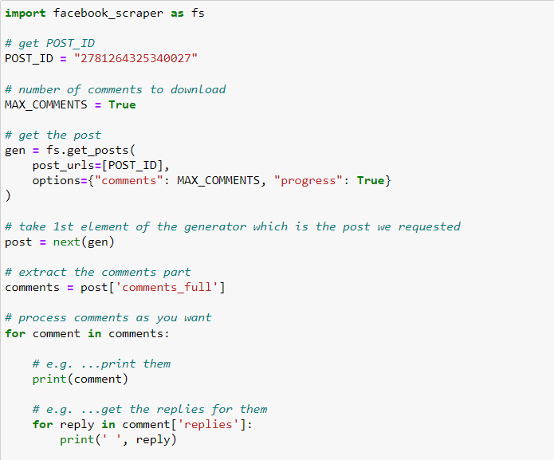
1.2 Data Source
Scraped from: Domino Pizza Official Facebook Page
Software: Jupyter Notebook
Programming Language: Python
Other tools: Comment Picker https://commentpicker.com/facebook-post-id-finder.php

Slide 7
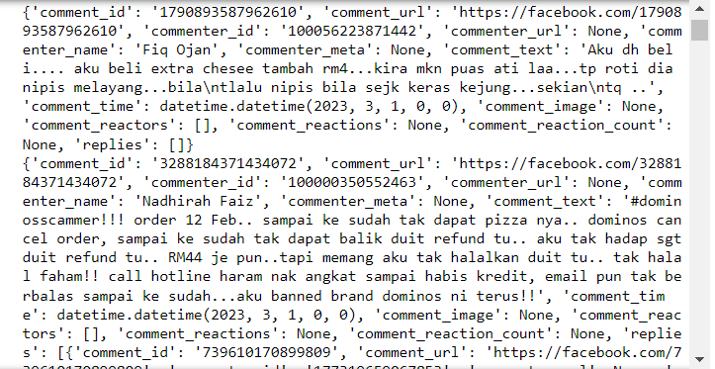
Parts of output for data scrapped

Slide 8
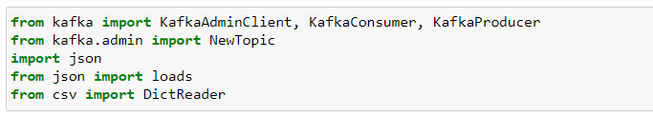
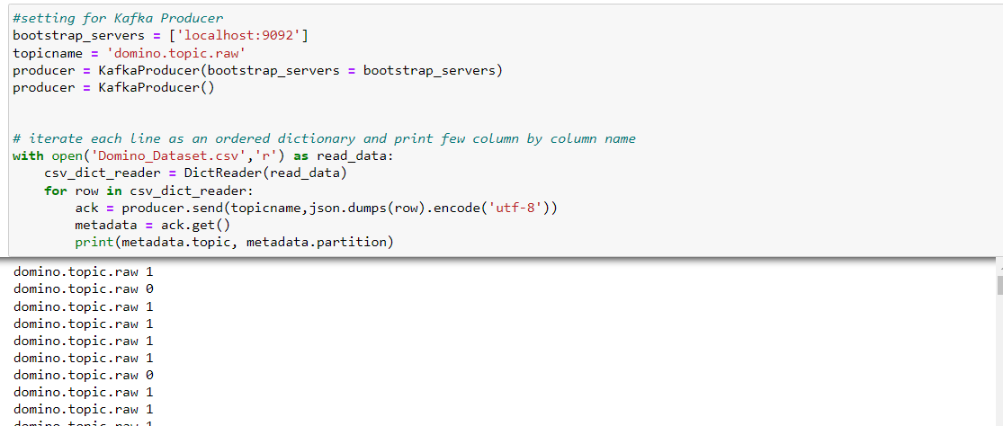
Setup for Kafka producer, convert file to json and upload to kafka

Slide 9

2. Extract, Transform, Load (ETL) / Extract, Load, Transform (ELT)

Slide 10
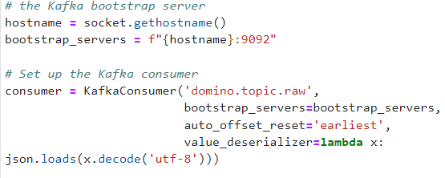
2.1 Extract, Transform, Load (ETL) Step
Extract: The first step of ETLis to extract data from a source system. In this code, the source system is Apache Kafka. The code uses the KafkaConsumer class to connect to the 'domino.topic.raw' topic in Kafka and consume the messages produced by the producer.

Slide 11
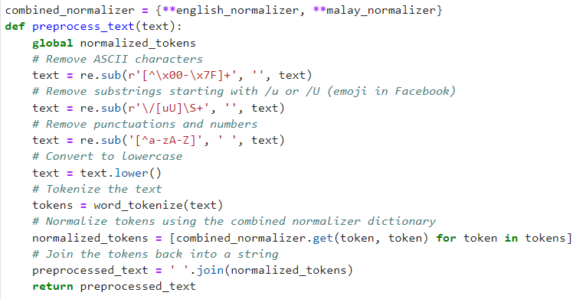
2.1 Extract, Transform, Load (ETL) Step
2. Transform: The next step of ETL is is to transform the extracted data into a desired format or structure

Slide 12
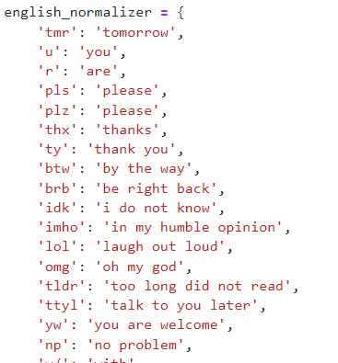
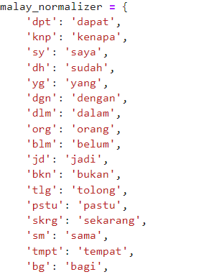
2.1 Extract, Transform, Load (ETL) Step
2. Transform: The next step of ETL is is to transform the extracted data into a desired format or structure

Slide 13
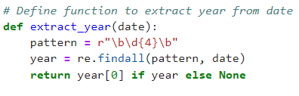
2.1 Extract, Transform, Load (ETL) Step
2. Transform: The next step of ETL is is to transform the extracted data into a desired format or structure

Slide 14
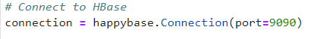
2.1 Extract, Transform, Load (ETL) Step
3. Load: The final step of ETL/ELT is to load the transformed data into a target system.

Slide 15
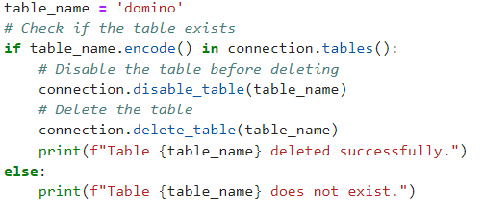
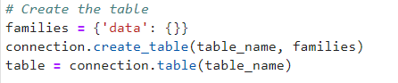
2.1 Extract, Transform, Load (ETL) Step
3. Load: The final step of ETL/ELT is to load the transformed data into a target system.

Slide 16
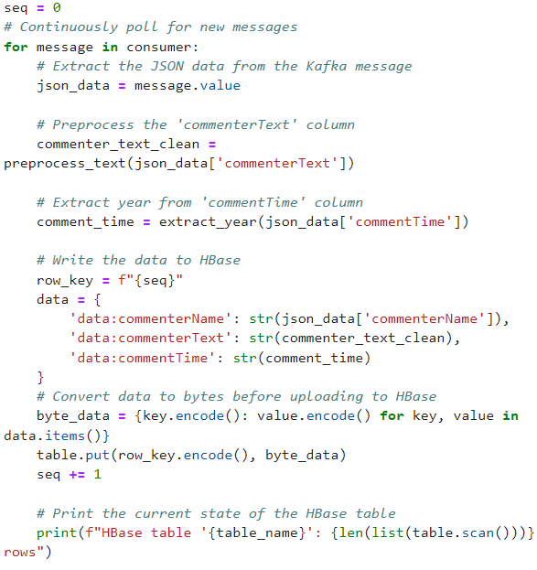
2.1 Extract, Transform, Load (ETL) Step
3. Load: The final step of ETL/ELT is to load the transformed data into a target system.

Slide 17
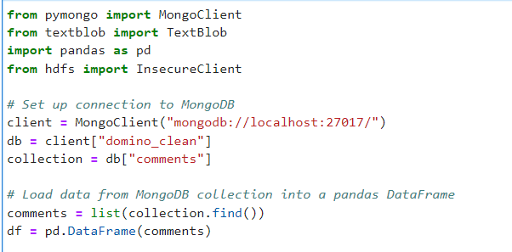
2.2 MongoDB
Set up connection MongoDB with db and collection

Slide 18
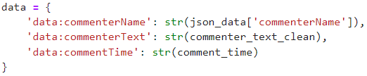
2.3 Hbase
Schema

Slide 19
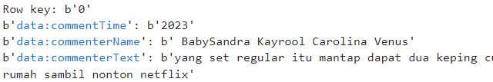
2.3 Hbase
File Format

Slide 20
MongoDB & Machine Learning

Slide 21

Sentiment Analysis

Slide 22
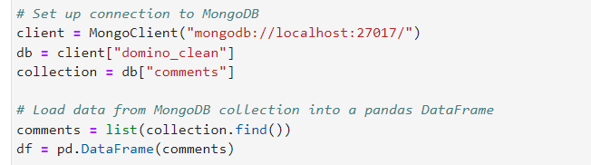
Retrieve data From MongoDB
Retrieve data from the MongoDB

Slide 23
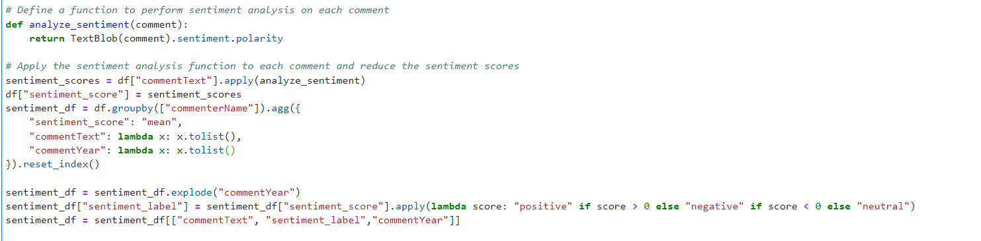
Define Sentiment analysis
Define sentiment analysis for each comment

Slide 24
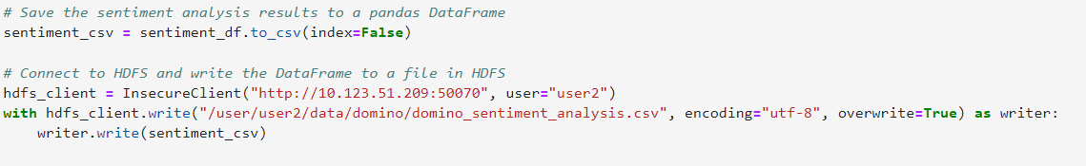
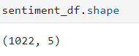
Store to HDFS

Slide 25

Data
Visualization

Slide 26
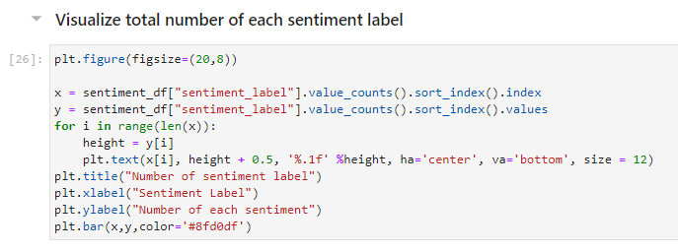
Visualize total number of each sentiment label
Code

Slide 27
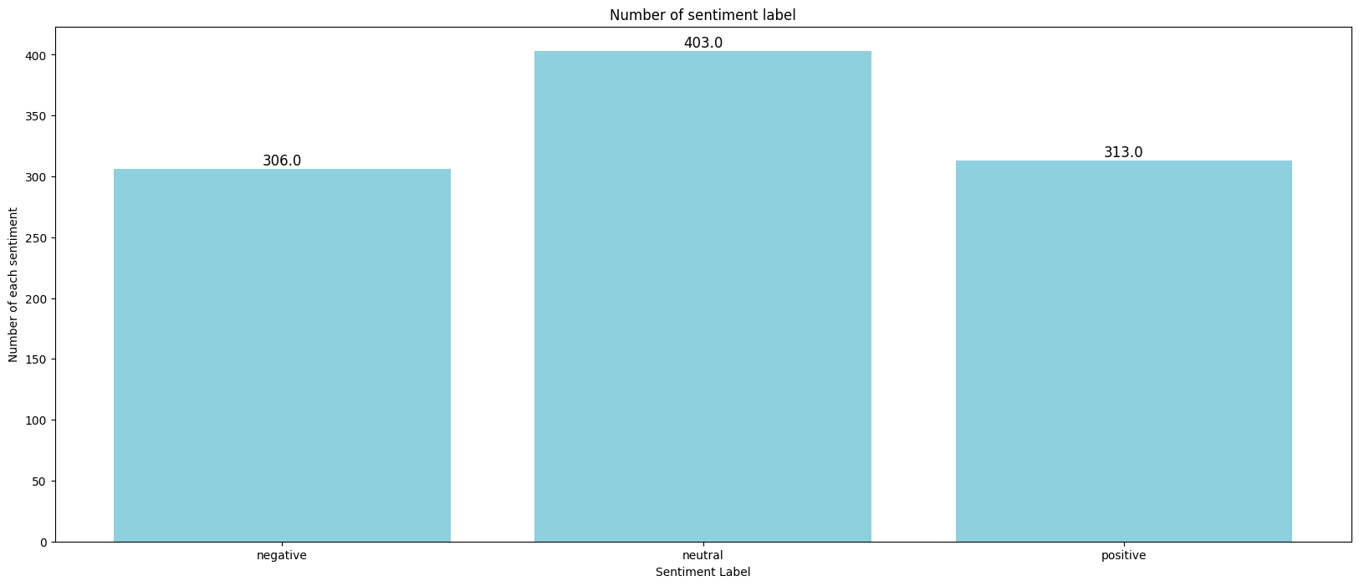
Visualize total number of each sentiment label
403 customers are neutral, 313 customers are satisfied, 306 of customers are dissatisfied

Slide 28
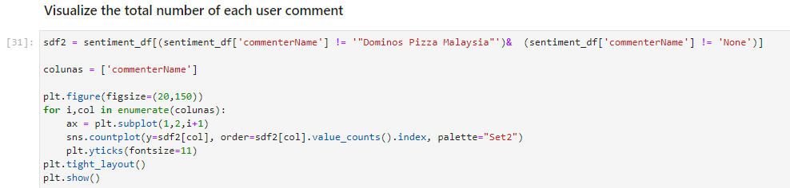
Total number of each user comment
Code

Slide 29
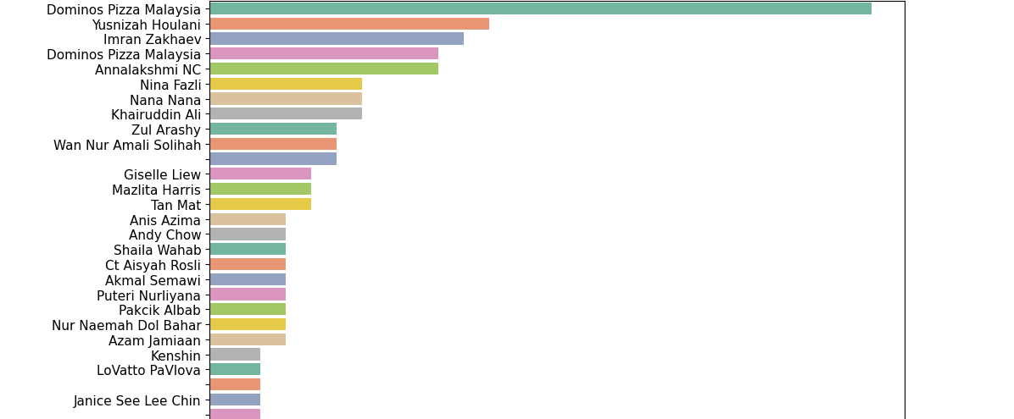
Total number of each user comment
Those customers who leave more than one comment are the Domino’s Pizza loyalty customers and they are familiar with Domino’s Pizza. We can say that their comments will be more reliable.

Slide 30
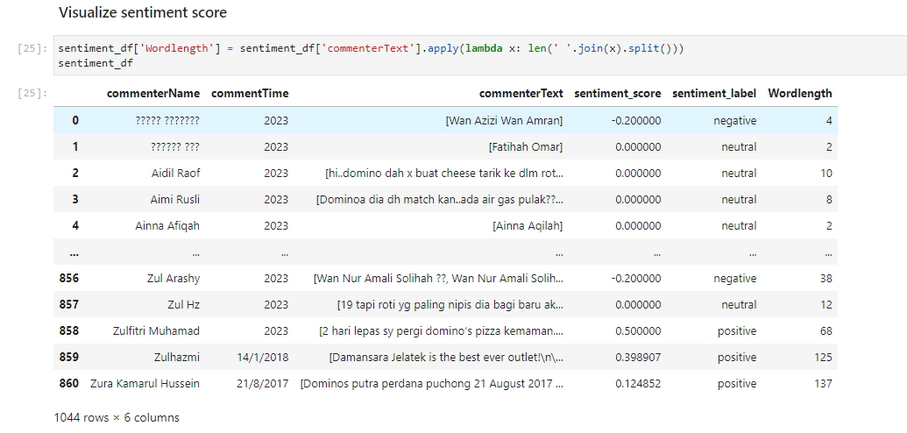
Sentiment Score Visualization
It shows longer the word count the higher the negative score.We assume that the customer would like provide more feedback to express their dissatisfied.

Slide 31
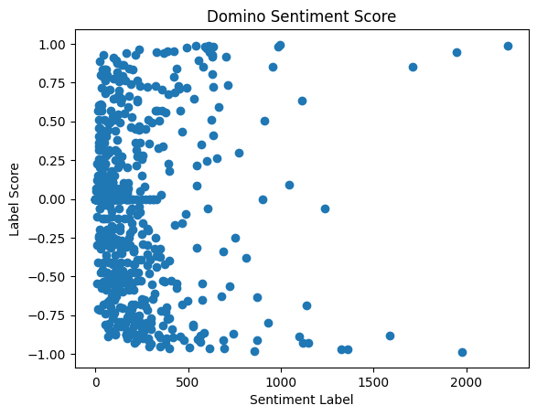
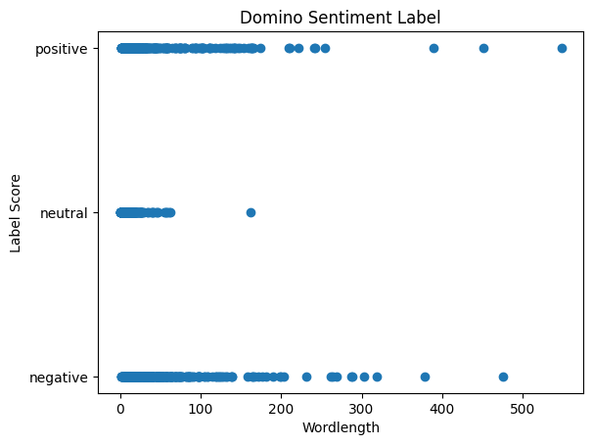
the longer the word count the higher the negative or positive score

Slide 32
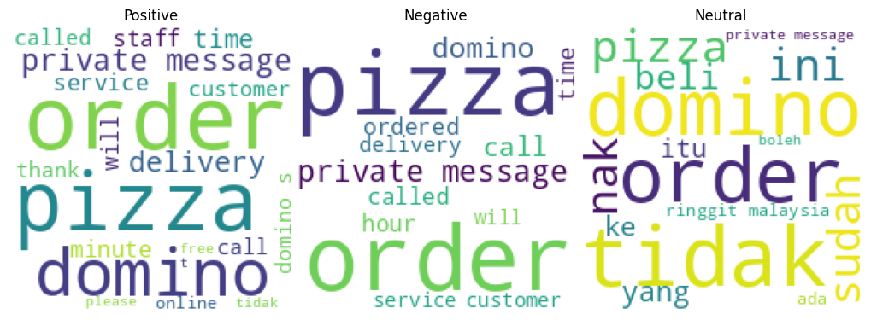
Word Cloud

Slide 33
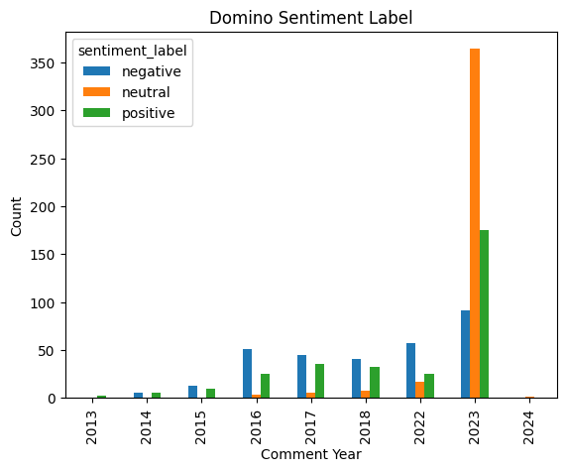
Total Number of each sentiment label by year

Slide 34

Thanks!

